Slide 1
Python 3 Programming
Multiprocessing and Multi-Threading

Slide 2
Contents
Multiprocessing vs Multi-Threading
Getting started
Multiprocessing - using os
Examples using os
Multiprocessing - using subprocess
Examples using subprocess
Subprocess – stdin, stdout and stderr
Subprocess - Pipelines
Multi-threading – the basics
Examples using threading
Using the multiprocessing module
Queue objects
Summary
Multiprocessing And
multithreading

Slide 3
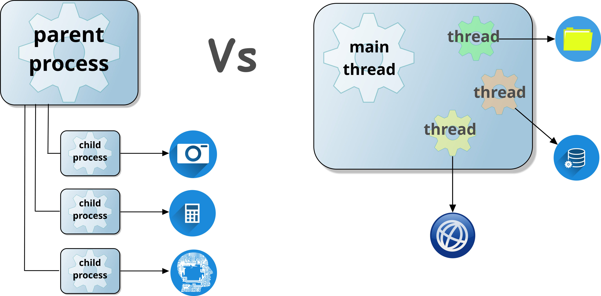
Multiprocessing Vs Multi-Threading
Multiprocessing
Spawn child processes
Each process gets its own memory space
Parallel execution in multiple cores
Fault Isolation
Suitable for CPU-bound tasks
Multi-Threading
Lightweight process
Runs independently
Shares memory with other threads
Limited by Global Interpreter Lock
Suitable for IO-bound tasks
Notes:
In Python, starting child processes and using multi-threading are useful for different reasons, but are mainly related to performance and concurrency.
Python’s Global Interpreter Lock (GIL) prevents multiple threads from executing concurrently, which means that in CPU-intensive tasks, threads do not improve performance. Instead, multiprocessing techniques allow child processes to be started that can benefit from multiple CPU cores and fault isolation in the event of one child process crashing.
Multiprocessing benefits:
Bypasses the GIL - each process gets its own memory space and interpreter allowing parallel execution in a multi-core CPU.
Performance - CPU-bound (tasks limited by speed of CPU) tasks such as machine learning, number crunching and image processing benefit from multiple cores.
Fault Isolation – a crash in one child process does not affect the others.
Although limited by GIL, Python threads are still suitable for I/O bound tasks - those waiting for input/output operations to complete:
Network requests – can handle multiple web-server requests.
File I/O – read and write to files concurrently.
Database queries – execute queries and wait for results.
Threads keep your programs responsive by allowing tasks to run asynchronously.
In this chapter, we will examine the techniques for starting child processes and threads and the role of the Global Interpreter Lock.

Slide 4
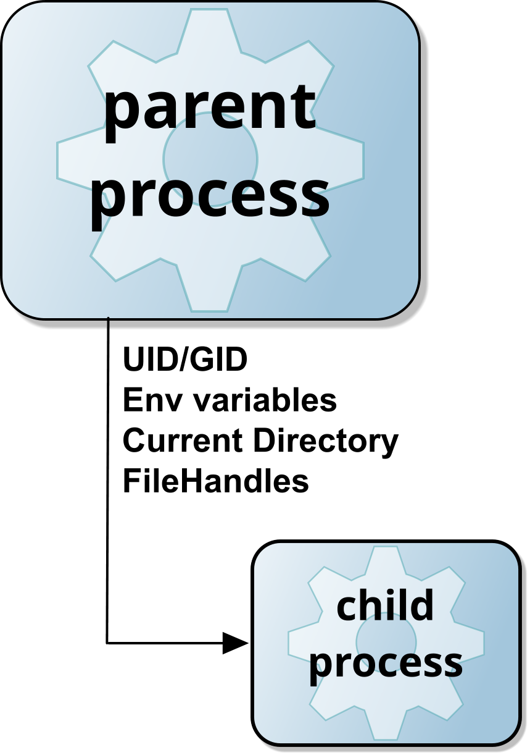
Multiprocessing
Family Life
A process is an instance of a program loaded and ready to run.
Every process has a parent, so every process is a child.
Family Inheritance
Child can inherit attributes of parent:
User ID, environment, directory and security.
Open files – depends on Python release (see notes).
Family Relationship – depends on OS
UNIX has strong family ties:
If parent dies, the child is an ‘orphan’.
Microsoft Windows has weak ties:
Parent must explicitly maintain a HANDLE to the child.
Can disown children but still supports inheritance.
Notes:
Most modern operating systems allow users to run multiple applications simultaneously, enabling non-interactive tasks to run in the background while they continue working in the foreground. Additionally, users can run multiple instances of the same program at the same time.
The two key operating-system object types that have a major role to play in multitasking are the ‘process’ and the ‘thread’. A process is an instance of a running program. Each process owns its own resources (code, data and the like) which are located in its own private address space. Any such resources created by a process are destroyed when the process terminates.
Before creating a process, we should consider the implications. Aside from the obvious performance overhead, creating another process forms a relationship between creator (the parent) and created process (the child).
Depending on the operating system, some items are inherited (copied) by the child process. On Microsoft Windows and UNIX, the child inherits the Environment block, the current directory, and security ID. Other things may be inherited, and both operating systems allow a degree of control over what exactly is inherited.
Open files are handled differently depending on the release of Python. Prior to Python 3.4, open file handles were inherited – and this is still the case in Python 2. In Python 3.4, open handles are no longer inherited by default, see PEP 446.

Slide 5
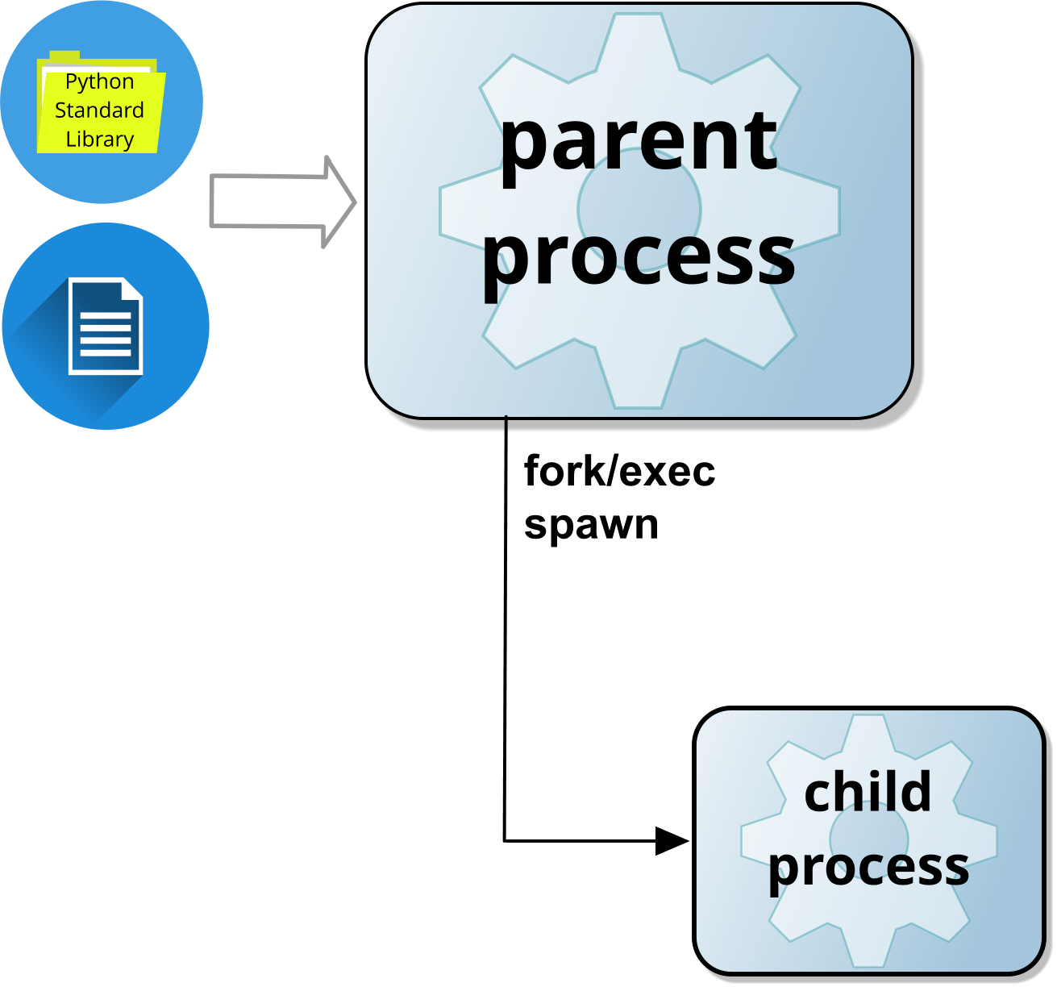
Getting started..
Python Standard Library modules:
Multi-Processing (Child processes)
os – limited functionality and platform support
Subprocess – running system processes
Multiprocessing – parallelism
Concurrent_futures – hi-level interface
Multi-Threading
threading – lightweight concurrency
asyncio – asynchronous programming for concurrency
Queue – thread safe communication
Notes:
Python provides several built-in modules for handling both multi-threading and multi-processing, allowing developers to efficiently manage tasks that run concurrently or in parallel. For multi-processing, the os module offers limited functionality for managing child processes, and it is platform-dependent. The subprocess module allows running system-level processes, while the multiprocessing module enables true parallel execution by creating separate processes, each with its own memory space, bypassing the Global Interpreter Lock (GIL). The concurrent.futures module (not covered) provides a high-level interface for managing threads and processes more easily, allowing you to submit tasks and handle results asynchronously.
On the other hand, for multi-threading, Python's threading module allows for lightweight concurrency within a single process, but due to the GIL, it is more suitable for I/O-bound tasks rather than CPU-heavy computations. The asyncio module is designed for asynchronous programming, allowing efficient handling of multiple tasks that spend time waiting, such as network requests. The Queue module (not covered) provides a thread-safe way for communication between threads, helping to manage data flow between concurrent tasks.
By using these modules, Python allows for flexible management of both CPU-bound and I/O-bound tasks, depending on the nature of the workload.

Slide 6

Multi-processing using os
Older, platform specific and deprecated:
os.fork()
UNIX specific – creates process
Requires exec*() functions to replace process with another program
Requires os.wait() or os.waitpid() to avoid a zombie
os.system()
Spawns a new process in subshell
Cross-platform alternative to fork() – runs a shell process (cmd.exe or bash).
Blocks execution until process completes – and returns exit status
os.spawn*()
Spawns a new process in subshell
Cross-platform alternative to fork() – can run in a similar mode to exec*()
os.popen()
Opens pipe to or from process – returns file like object for .read() and .write()
Can interact with stdin/stdout but better to use subprocess.Popen()
Notes:
The os module provides functionality that supports multi-processing but is not specifically designed for parallel execution or standard behaviours on different operating systems.
The functions listed above are system-specific, meaning their behaviour varies significantly across different operating systems. These differences stem from the architectural variations of the operating systems they operate on.
On UNIX and Linux, launching a new program typically follows a two-stage process:
Forking – The current process is duplicated, creating a child process that inherits the parent's program and execution state.
Executing (exec) – The child process replaces its program with a different one.
The exec function has multiple variations, depending on whether:
A different environment block is required.
The PATH variable is used to locate the program.
Arguments are passed in a specific format.
By contrast, the VMS operating system (from DEC) used a different approach, known as spawning, which created a new process running a different program in a single step. Windows, inheriting certain architectural features from VMS, adopted spawn, which serves a similar purpose to UNIX’s exec but also has multiple forms depending on how the new program is executed.
To standardize process creation, the C standard library introduced system(), which invokes a shell to launch a new process. However, this approach was inefficient and lacked asynchronous capabilities.
These architectural differences are reflected in the older os module interfaces, many of which are now deprecated. While you may still encounter them in legacy code, modern Python programs should prefer the subprocess module for process management.
Additionally, older versions of Python on UNIX included the commands module, which was removed in Python 3. On Windows, os.startfile() allows a file to be opened using its associated program - functioning similarly to double-clicking a file in Windows Explorer.

Slide 7

Examples using os
os.fork()
os.spawn()
os.system()
os.popen()
def run_command():
print(f"Running in process ID: {os.getpid()}")
os.system("echo Hello from child process")
pid = os.fork() # Fork the process
if pid == 0: # Child process
run_command()
else: # Parent process
print(f"I’m the parent(os.getpid()) of child {pid}")
if os.name == 'nt':
os.spawnl(os.P_NOWAIT, r"C:\Windows\System32\calc.exe", "calc.exe")
else:
os.spawnlp(os.P_NOWAIT, "echo", "echo", "Hello World")
status = os.system("echo hello from Child")
print("Child exited with", status)
for line in os.popen(r"C:\Windows\System32\tasklist.exe").readlines():
print(":", line, end="")
Notes:
The os.fork() example demonstrates how a child process is created by duplicating the parent process. The child process runs a Unix command (echo Hello from child process), while the parent continues execution separately. Since fork() is not available on Windows, the multiprocessing module should be used instead for cross-platform compatibility.
This os.system() function runs a shell and waits for it to finish. In the example, os.system("echo Hello from Child”) executes the echo command, printing a message to the console. While simple, os.system() blocks execution and is generally replaced by subprocess.run() for better control and security.
Unlike os.system(), os.spawn() can create a new process without waiting for it to complete. The example launches calc.exe on Windows and runs the echo command on UNIX. Unlike fork(), spawn() is available on both Windows and UNIX, making it a more portable option.
os.popen() opens a process and reads its output like a file. In the example, os.popen() executes the Windows tasklist command, and the for loop iterates through and prints each line. Since os.popen() is deprecated, subprocess.Popen() is recommended for more robust process management.
Nobody can be sure if a Dodo can program in Python, but if it could, it would have stopped using the os module for multi-processing a long time ago!

Slide 8

Multi-processing using subprocess
Unifying process creation:
Cross-platform - to replace os.system() and os.spawn().
Better control over input, output and errors
From Python 3.5, the preferred interface is:
subprocess.run() for simple tasks
subprocess.popen() for more complex tasks
Returns a subprocess object.
Parameters are discussed later.
Other shortcuts are available:
call() ,check_call(), getoutput() and getstatusoutput (UNIX specific).
We discuss the multiprocessing package later:
Runs processes in a similar way to threads.
Notes:
The subprocess module was introduced in Python 2.4 to unify the various process creation and management interfaces in the standard library. It aimed to provide a consistent, cross-platform solution without operating system-specific quirks - though this goal was not achieved entirely.
While older functions like os.system(), os.spawn(), and os.popen() are still supported, they are deprecated for new applications. Developers should refer to the "Replacing Older Functions with the subprocess Module" section in the official documentation for guidance on modern best practices. With the adoption of Python 3, it is the perfect time to transition away from legacy methods in favour of subprocess which offers greater control, security, and flexibility.
Additionally, we will explore the multiprocessing module which offers an alternative approach for running processes.

Slide 9
Using subprocess.run()
Run a program and wait for it to complete.
Added in Python 3.5 and is a wrapper around Popen.
Syntax:
Returns a subprocess.CompletedProcess object.
returncode
stdout only if routed to a PIPE (see later)
stderr only if routed to a PIPE (see later)
run(*args, input=None, timeout=None, check=False, **kwargs)
args Command-line to execute (a sequence)
input Data to be passed to stdin of the program
timeout A timeout value in seconds.
Raise a subprocess.TimeoutExpired exception if exceeded
check If True, raise a subprocess.CalledProcessError if exit code != 0 kwargs Optional Popen arguments (see later)
Notes:
The subprocess.run() method was introduced in Python 3.5 to simplify process execution using subprocess. It serves as a wrapper around Popen, which, while powerful, can be complex and requires explicitly waiting for the process to complete. In contrast, subprocess.run() waits by default, making it more convenient for most use cases.
One of the key advantages of subprocess.run() is the timeout parameter, a frequently requested feature that is not natively available with Popen.
For users who need the full flexibility of Popen, subprocess.run() still allows access to its advanced functionality - all Popen parameters can be passed through.
Finally, note that the example shown is derived from the built-in help text, not the official documentation.

Slide 10
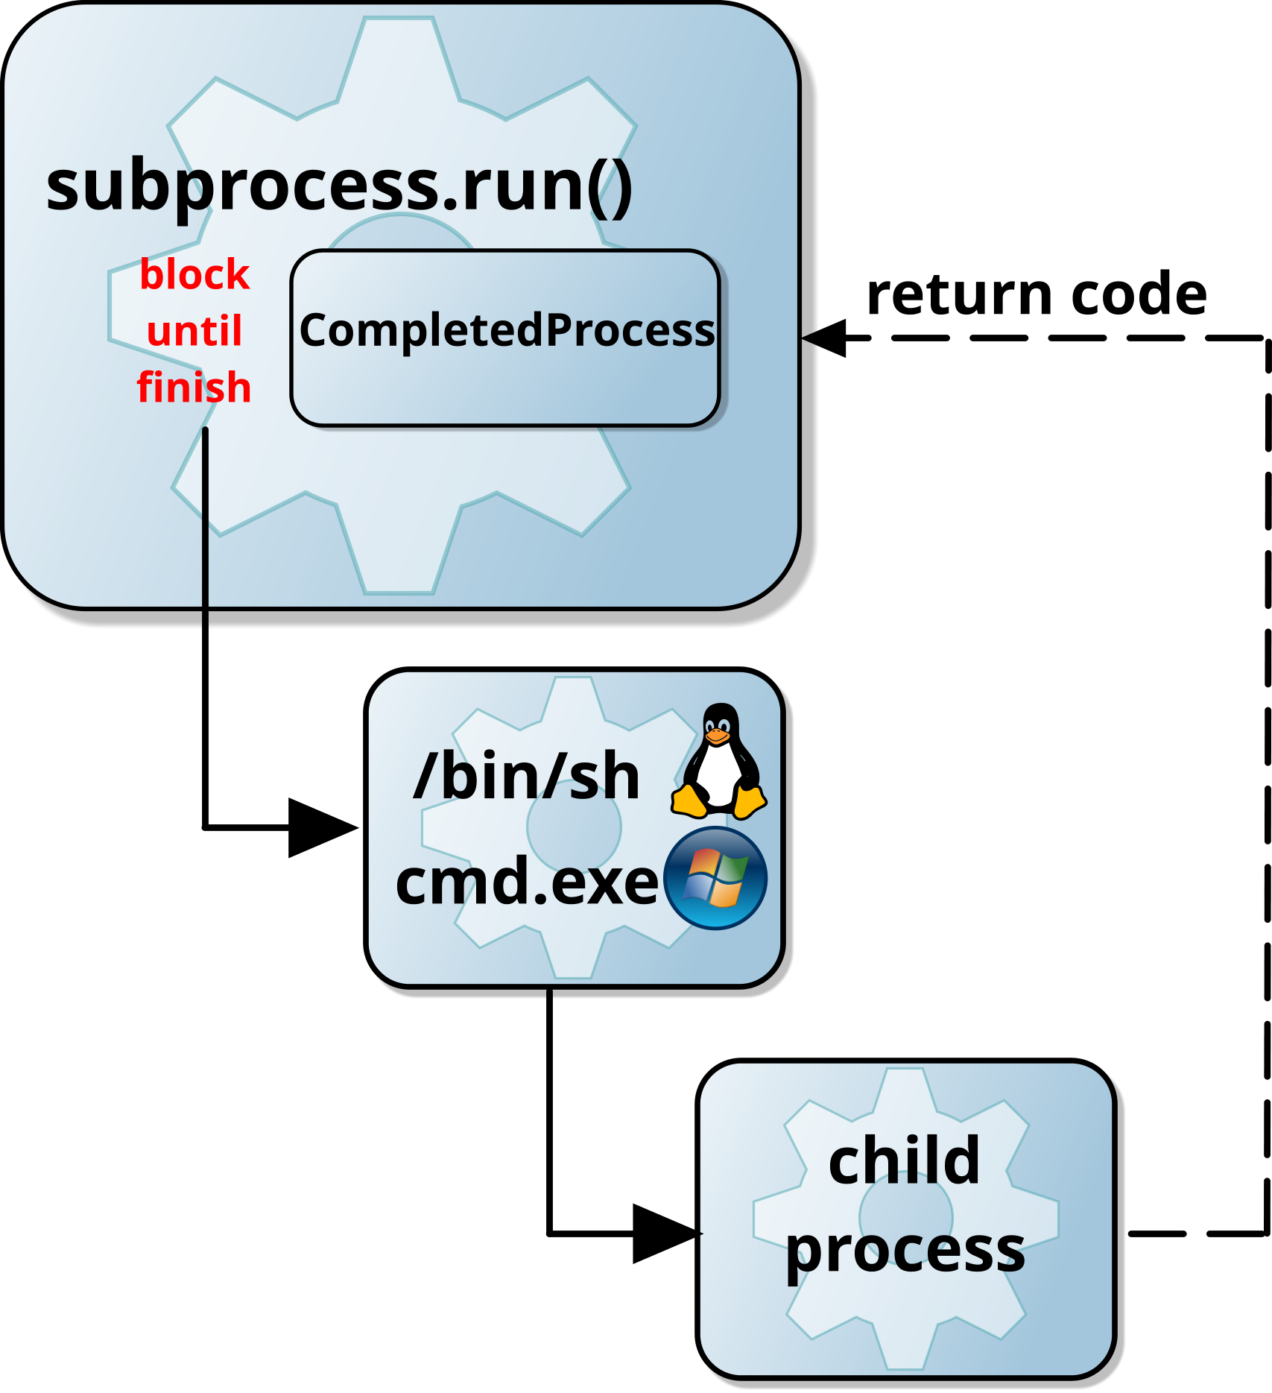
Example - running a basic subprocess
Run a process and wait for it to complete.
A shell is sometimes required when:
Using shell wildcards, pipes, redirections, etc.
Using Windows and file association is required
Don't use a shell if you don't need to.
It can add an unnecessary overhead.
Pass a list instead
import subprocess
proc = subprocess.run('hello.py', shell=True)
print('Child exited with', proc.returncode)
import subprocess
proc = subprocess.run([sys.executable, 'hello.py'])
Typically:
C:\Python313\python.exe
Notes:
This slide introduces the simplest way to run another program using subprocess.run(), which is functionally similar to os.system() but offers more flexibility and security. Typically, the command is passed as a single argument, often in the form of a string or a list.
The first parameter to subprocess.run() can be either a string or a list. If using a string, ensure that each command component is separated by a space. For example, the following can be used to run a Python script:
cmd = sys.executable + ' hello.py '
proc = subprocess.run(cmd)
Unlike os.system(), subprocess.run() does not use a surrogate shell by default, unless explicitly requested via Popen parameters. If shell features like wildcard expansion (globbing) are required, a shell is necessary—but in Python, it's often better to use the glob module instead.
Windows users are accustomed to clicking a file and expecting it to launch the correct program. However, file association is not handled by the operating system - it is managed by the application launching it (e.g., Windows Explorer or cmd.exe). Since subprocess.run() does not handle file associations, you must:
Provide the full program name yourself (which is more efficient), or
Use a shell to handle file association automatically.
For Python programs, the interpreter's full path is available in sys.executable. If you need file association on Windows, consider using os.startfile() instead.

Slide 11
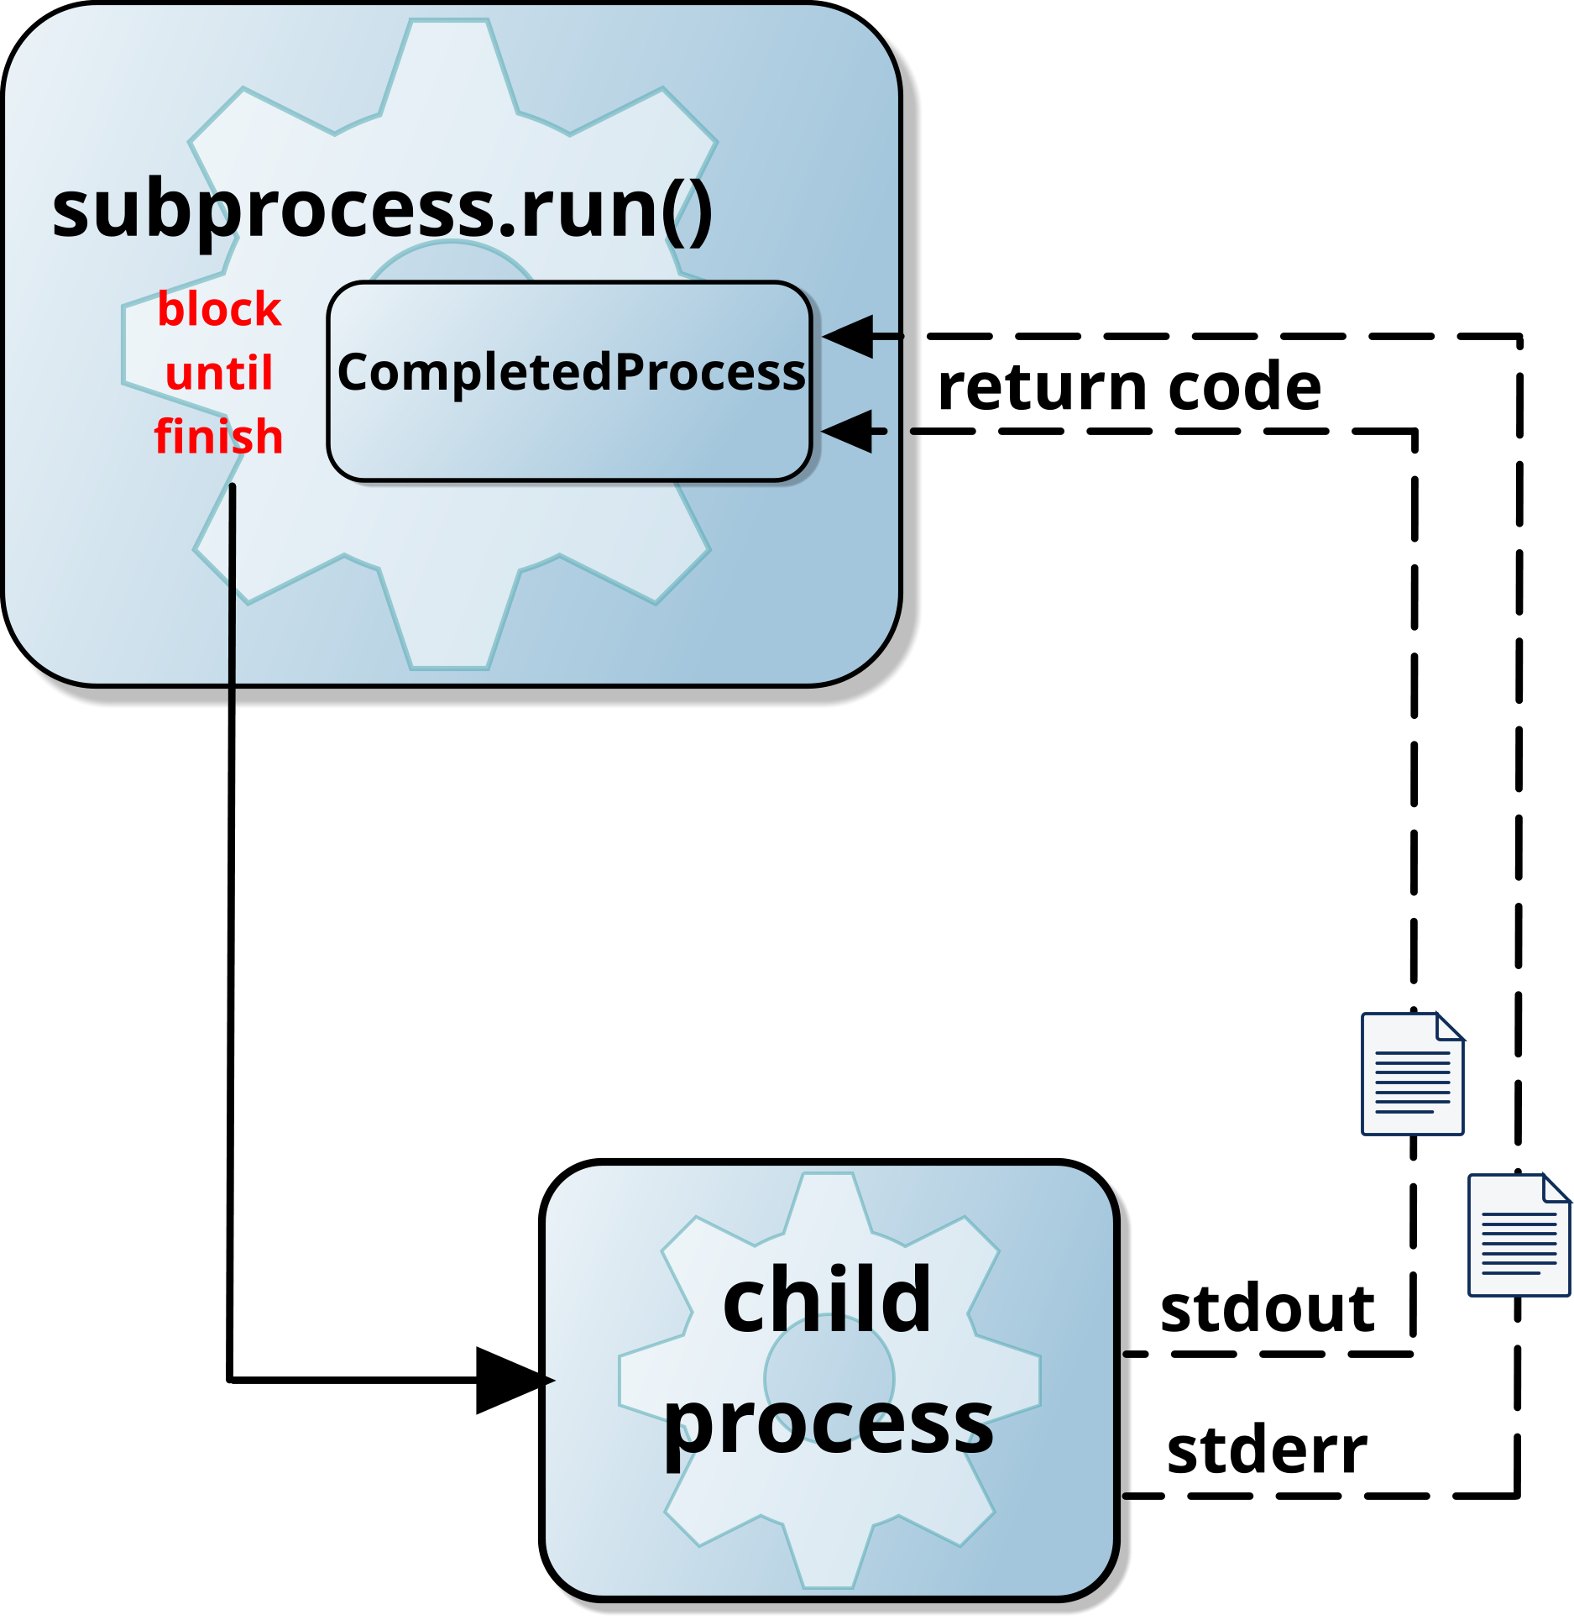
Example - capturing the output
Use the returned CompletedProcess object:
Includes stdout, and stderr, but only when using PIPE.
Use bytes.decode() to convert bytes to string.
Use string.encode() to convert string to bytes (for stdin).
Warning, data is stored in memory - may crash your program!
import subprocess
proc = subprocess.run("tasklist",
stdout=subprocess.PIPE,
stderr=subprocess.PIPE)
if proc.stderr != None:
print ("error:", proc.stderr.decode())
print("output:", proc.stdout.decode())
Notes:
Capturing the stdout (standard output) from a child process using subprocess.run() is similar to using backticks ` ` or $(command) substitution in UNIX/Linux shells. This method allows you to retrieve the output directly into Python.
However, it is best suited for small amounts of data since the entire output is stored in memory before further processing can continue.
The CompletedProcess object returned by subprocess.run() includes the output from both stdout and stderr, but only if the process is executed with PIPE for these streams.
Both stdout and stderr are captured as byte streams rather than strings. If you need to manipulate the output as text, you may need to decode it. Alternatively, use text=True to return strings instead of bytes.

Slide 12
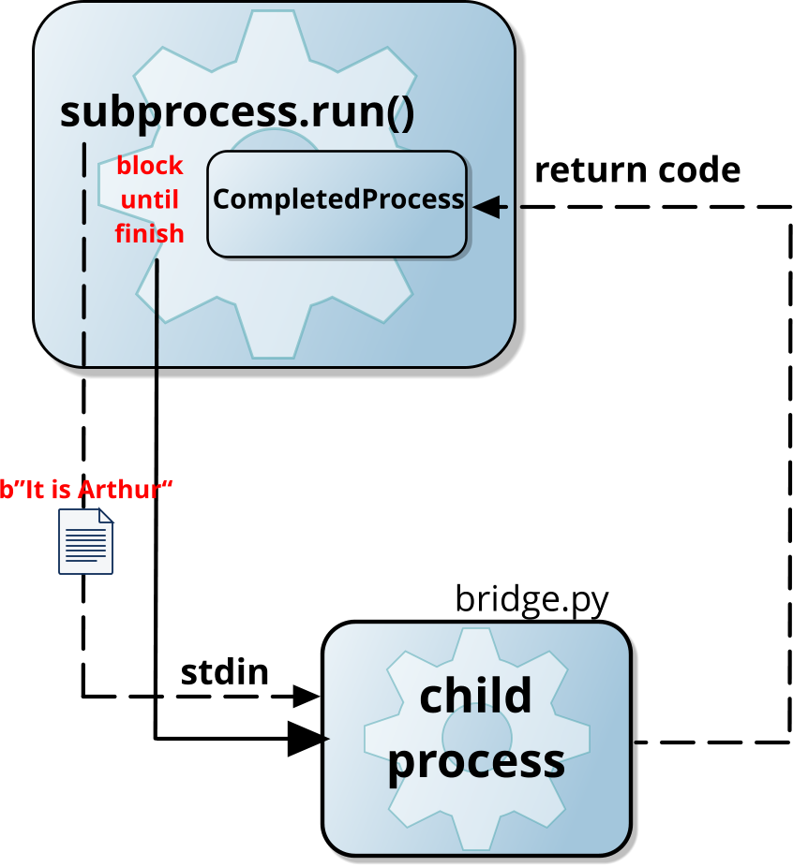
Example - passing data into stdin
Suitable for simple text
Bytes objects only
bridge.py
import subprocess
proc = subprocess.run("bridge.py",
input=b"It is Arthur")
reply = input(“What…is your name? ")
print(f"<{reply}>" )
What is your name? <It is Arthur>
Notes:
Passing data through stdin is less common but can be useful. The subprocess.run interface simplifies this process for single strings using the input parameter.
However, note that native strings (str) cannot be used directly—input requires a bytes object.

Slide 13
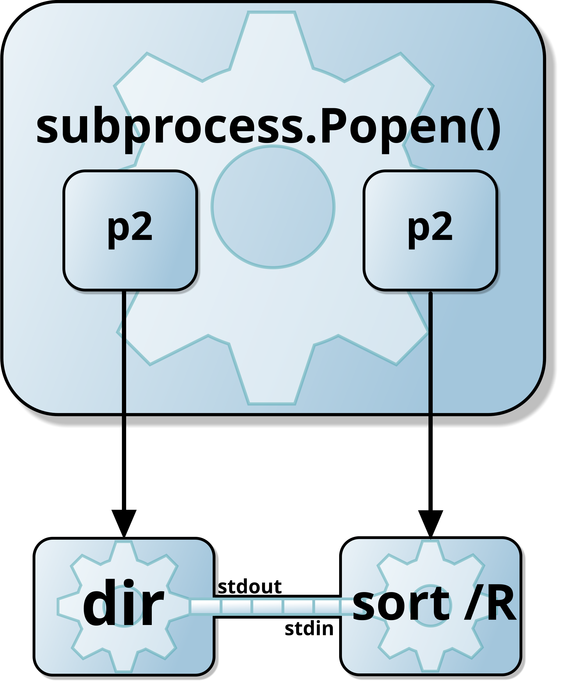
Pipelines using subprocess.Popen()
Benefits of using subprocess.Popen()
Greater control – better management of child processes
Command pipelining – data flow from stdout to stdin
Non-blocking execution - asynchronous processing
Error Handling – captures stdout and stderr separately
Resource Management – can prevent deadlocks
import subprocess
p1 = subprocess.Popen('dir', shell=True,
stdin=None,
stdout=subprocess.PIPE,
stderr=subprocess.PIPE)
p2 = subprocess.Popen('sort /R', shell=True,
stdin=p1.stdout)
p1.stdout.close()
out, err = p2.communicate()
Notes:
The subprocess.Popen() function is useful when executing multiple commands that need to interact through a pipeline. In this example:
p1 runs the dir command, listing directory contents. Its output is captured using stdout=subprocess.PIPE.
p2 runs sort /R, which sorts input in reverse order. The stdin=p1.stdout parameter connects it to p1, creating a pipeline.
p1.stdout.close() prevents deadlocks by closing p1's output once it's passed to p2.
p2.communicate() ensures p2 completes execution and retrieves its output (out) and errors (err).
This approach allows for greater flexibility when chaining commands programmatically.

Slide 14
The subprocess.Popen class parameters
Key points on subprocess.Popen parameters:
Defaults work well – optimised based on system defaults
File inheritance disabled except stdin, stdout and stderr
args Command-line to execute (a sequence)
bufsize=-1 Buffersize 0: unbuffered < 0: default buffsize
executable=None Program to be executed, rarely needed
stdin=None Handle used for stdin (can be PIPE)
stdout=None Handle used for stdout (can be PIPE)
stderr=None Handle used for stderr (can be STDOUT)
preexec_fn=None Code to call before the program (UNIX)
close_fds=True Do not inherit open file handles
shell=False Use a shell to execute the command
cwd=None Working directory of the child process
env=None Environment block of the child process
universal_newlines=False See any of '\r' or '\n' as newlines
startupinfo=None Windows only STARTUPINFO struct
creationflags=0 Windows only creation flags
Notes:
Buffer Size Selection
If unsure, use the default buffer size. The default value of -1 was updated in Python 3.3.1 to automatically use the system's default buffer size.
File Descriptor Inheritance
In many languages, child processes inherit open file handles (file descriptors on UNIX). Older interfaces required manual handling (e.g., using fcntl on UNIX) to prevent this. However, subprocess disables inheritance by default (close_fds=True), except for stdin, stdout, and stderr, which are typically needed.
Windows-Specific Parameters
startupinfo: Controls the appearance of the new process’s main window (e.g., position, title).
creationflags: Defines process settings like priority levels.
For more details, refer to MSDN and the low-level Windows API function CreateProcess.

Slide 15
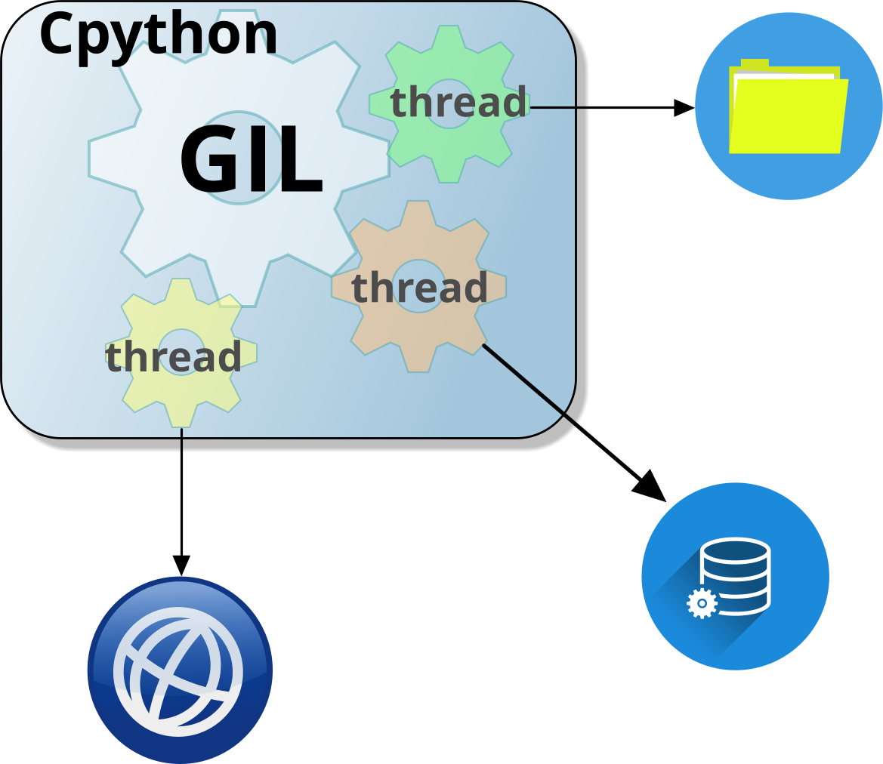
Multi-threading – the basics
What is a thread?
Smallest unit of processing within the process
Benefits
Shared memory and low CPU overhead
Fast switching between threads
Concurrency, not always parallelism – due to GIL
Life of a Thread
States - New, Running/Blocked and Terminated
Thread safety matters
Use locks to sync access to resources and avoid race conditions
Modules
Different mechanisms and use cases:
threading – multi-threaded running concurrently, restricted by GIL
asyncio - single-threaded events, async co-routines, non-blocking
Or create our own class derived from threading.Thread
Notes:
A thread is the smallest unit of execution within a process. Unlike processes, multiple threads within the same program share the same memory space and allow a program to perform multiple tasks concurrently within the same process.
Threads provide several benefits:
Lightweight: Threads share same memory and Python interpreter within the process.
Shared Resources: Threads can access the same data but requires synchronisation to avoid conflicts.
Fast Context Switching: Switching between threads is quicker than switching between processes.
Concurrency, not always parallelism: Due to Python’s Global Interpreter Lock (GIL), threads enable concurrency but not true parallelism for CPU-bound tasks. However, multi-threading is useful for I/O-bound operations, such as file handling or network requests.
A thread goes through several states during its lifecycle. When a thread is created but not yet started, it is in the New state. Once started, it moves to the Running state, where it actively executes code. If the thread encounters a resource constraint (e.g., waiting for I/O or a lock), it enters the Blocked state until the resource becomes available. Finally, when the thread completes execution or is forcefully stopped, it enters the Terminated state, where it can no longer run.
Since threads share memory, multiple threads modifying shared data simultaneously can lead to race conditions, causing unpredictable behaviour. To prevent this:
Use locks (threading.Lock) to synchronize access to shared resources and ensure that only one thread modifies data.
Be cautious of deadlocks, where two or more threads become stuck waiting for each other to release a resource, preventing further execution.
Python modules offer different approaches for handling concurrency:
threading – this implements traditional multi-threading, where multiple threads run concurrently but are still restricted by the Global Interpreter Lock (GIL). Best suited for I/O-bound tasks, such as file operations or network requests.
asyncio – this uses a single-threaded, non-blocking event loop with async coroutines, allowing efficient management of thousands of lightweight tasks. Ideal for asynchronous operations like UI interfaces, web requests, database queries, and real-time applications.
It's time to explore how to use the threading and asyncio modules.

Slide 16



Example using threading module
Compare Single threaded Vs Multi-threaded
Example using a cycle race simulation
Single threaded:
import time
def c_race(racer, handicap):
for distance in range(0, 1001, 100):
print(f"{racer} - {distance} m")
time.sleep(handicap)
return None
print("Race starting 3..2..1..")
c_race("Racer 1", 1.637)
c_race("Racer 2", 1.587)
print("Race Finished")
Race starting in 3... 2... 1...
Racer 1 - 0m
Racer 1 - 100m
Racer 1 - 200m
Racer 1 - 300m
Racer 1 - 400m
Racer 1 - 500m
Racer 1 - 600m
Racer 1 - 700m
Racer 1 - 800m
Racer 1 - 900m
Racer 1 - 1000m
Racer 2 - 0m
Racer 2 - 100m
Racer 2 - 200m
Racer 2 - 300m
Racer 2 - 400m
Racer 2 - 500m
Racer 2 - 600m
Racer 2 - 700m
Racer 2 - 800m
Racer 2 - 900m
Racer 2 - 1000m
Race finished!
Notes:
This program simulates a simple race where two racers progress in increments of 100 meters at different speeds. The c_race function takes a racer’s name and a handicap (delay time per step), printing their progress every 100 meters and pausing based on the handicap value using time.sleep().
The program runs sequentially, meaning Racer 1 completes their race before Racer 2 starts. Since Python executes functions one at a time in a single-threaded environment, the second racer must wait for the first to finish.

Slide 17

Example using threading module
Compare Single threaded Vs Multi-threaded
Use threading.Thread to create threads t1 and t2
Use start() to execute threads and join() to wait until t1 and t2 finish
import time
from threading import Thread
def c_race(racer, handicap):
for distance in range(0, 1001, 100):
print(f"{racer} - {distance}m")
time.sleep(handicap)
return None
print("Race starting 3..2..1..")
t1 = Thread(target=c_race, args=("Racer 1", 1.637))
t2 = Thread(target=c_race, args=("Racer 2", 1.587))
t1.start() # Execute threads t1 and t2
t2.start()
t1.join() # Main thread waits till t1 and t2 finish
t2.join()
print("Race finished")
Race starting in 3... 2... 1...
Racer 1 - 0m
Racer 2 - 0m
Racer 1 - 100m
Racer 2 - 100m
Racer 2 - 200m
Racer 1 - 200m
Racer 1 - 300m
Racer 2 - 300m
Racer 1 - 400m
Racer 2 - 400m
...
Race finished!
Racer 1 and Racer 2 print messages
at the same time, causing interleaved
output that may appear different every
time you run the program
Notes:
Unlike the single-threaded version, the multi-threaded implementation allows both racers to progress simultaneously. The threading.Thread class is used to create separate threads for each racer, with start() beginning execution in parallel and join() ensuring all threads are complete before the program exits.
Because threads share the same memory space, using threading enables concurrency, making it ideal for I/O-bound tasks. However, due to Python’s Global Interpreter Lock (GIL), this approach does not achieve true parallel execution for CPU-bound tasks.
And in this instance, it results in a more exciting cycle race!

Slide 18
Synchronisation objects in threading
Thread objects for synchronisation:
Condition variables
Threads wait for a specific condition before proceeding (e.g.in producer-consumer)
Events
Simple signalling mechanism where one thread sets an event and others wait for it
Thread local storage
Each thread can maintain its own versions of a global variable preventing conflict
Locks
Similar to mutex, concept of ownership so only one thread can access a resource at a time
Semaphores
Allow a limited number of threads to access a resource (e.g., restricting access to 3 threads)
Timers
Execute functions after a delay or at regular intervals; useful for scheduling tasks.
Notes:
The threading module provides several synchronization objects to help coordinate thread execution and prevent race conditions. These objects ensure safe access to shared resources and control the flow of multiple threads.
Condition Variables – Derived from the POSIX pthreads library, condition variables include an internal Lock to protect a predicate (a shared condition that threads check before proceeding). They are more complex than Event objects but useful for fine-grained synchronization.
Events – Simple and easy to use, Event objects allow one thread to signal others when a condition is met. Threads wait for an event to be set, and another thread releases them. They also support a timeout, making them ideal for coordination without explicit locking.
Thread-Local Storage (TLS) – Allows each thread to have its own version of a global variable, making it thread-safe. While considered a hack for converting single-threaded code to multi-threaded - it's better to avoid global variables altogether.
Locks – The fundamental synchronization primitive. A Lock can be either acquired (owned by a thread) or released, ensuring mutual exclusion for shared resources. If another thread tries to acquire an already locked resource, it must wait until it is released.
Semaphores – Unlike locks, semaphores do not have an owner. They control access to a limited number of resources, allowing multiple threads to proceed up to a specified limit. If the limit is reached, additional threads must wait until a slot becomes available.
Timers – Used to trigger functions after a specified delay or at regular intervals. This is useful for scheduled tasks or periodic updates in multi-threaded programs.
By choosing the right synchronisation mechanism you can manage concurrent execution and safer access to shared resources without unnecessary complexity. 🚀

Slide 19


Example using threading locks
To fix the interleaved print issue:
Using .acquire() and .release() instead of with statement
import time
from threading import Thread, Lock
print_lock = Lock()
def c_race(racer, handicap):
for distance in range(0, 1001, 100):
with print_lock:
print(f"{racer} - {distance}m")
time.sleep(handicap)
return None
print("Race starting 3..2..1..")
t1 = Thread(target=c_race, args=("Racer 1", 1.637))
t2 = Thread(target=c_race, args=("Racer 2", 1.587))
t1.start() # Execute threads t1 and t2
t2.start()
t1.join() # Main thread waits till t1 and t2 finish
t2.join()
print("Race finished")
def c_race(racer, handicap):
for distance in range(0, 1001, 100):
print_lock.acquire()
try:
print(f"{racer} - {distance}m")
finally:
print_lock.release()
time.sleep(handicap)
return None
Race starting in 3... 2... 1...
Racer 1 - 0m
Racer 1 - 100m
Racer 1 - 200m
Racer 1 - 800m
Racer 1 - 900m
Racer 1 - 1000m
Racer 2 - 0m
Racer 2 - 100m
Racer 2 - 200m
Racer 2 - 300m
Racer 2 - 900m
Racer 2 - 1000m
Race finished!
Notes:
In the cycle race simulation, using locks from the threading module ensures that shared resources are accessed safely when multiple threads are running concurrently. This prevents race conditions where threads might attempt to modify shared data simultaneously, leading to unpredictable results. By acquiring a lock before accessing shared data and releasing it afterward, we can ensure that only one thread modifies the resource at a time.
The Lock object acts as a gatekeeper, allowing a thread to proceed while blocking others until the lock is released. This approach is useful in scenarios where multiple threads need to write to a shared console or update a shared data structure, such as the race progress.
In the code example, we wrap the critical section of the code — the part where the distance covered by each racer is printed — inside a lock. This prevents the output from becoming jumbled due to simultaneous access by different threads. By doing so, the race simulation output remains clear and accurate.
An alternative way to manage locks is through explicit calls to .acquire() and .release(). While using the with statement is often preferred for its simplicity and automatic handling of exceptions, explicitly acquiring and releasing the lock allows for more fine-grained control. For instance, you can acquire the lock, perform multiple operations, and then release the lock only when all operations are complete. However, this approach requires careful handling to avoid deadlock situations where a thread holds a lock indefinitely, preventing other threads from proceeding.

Slide 20
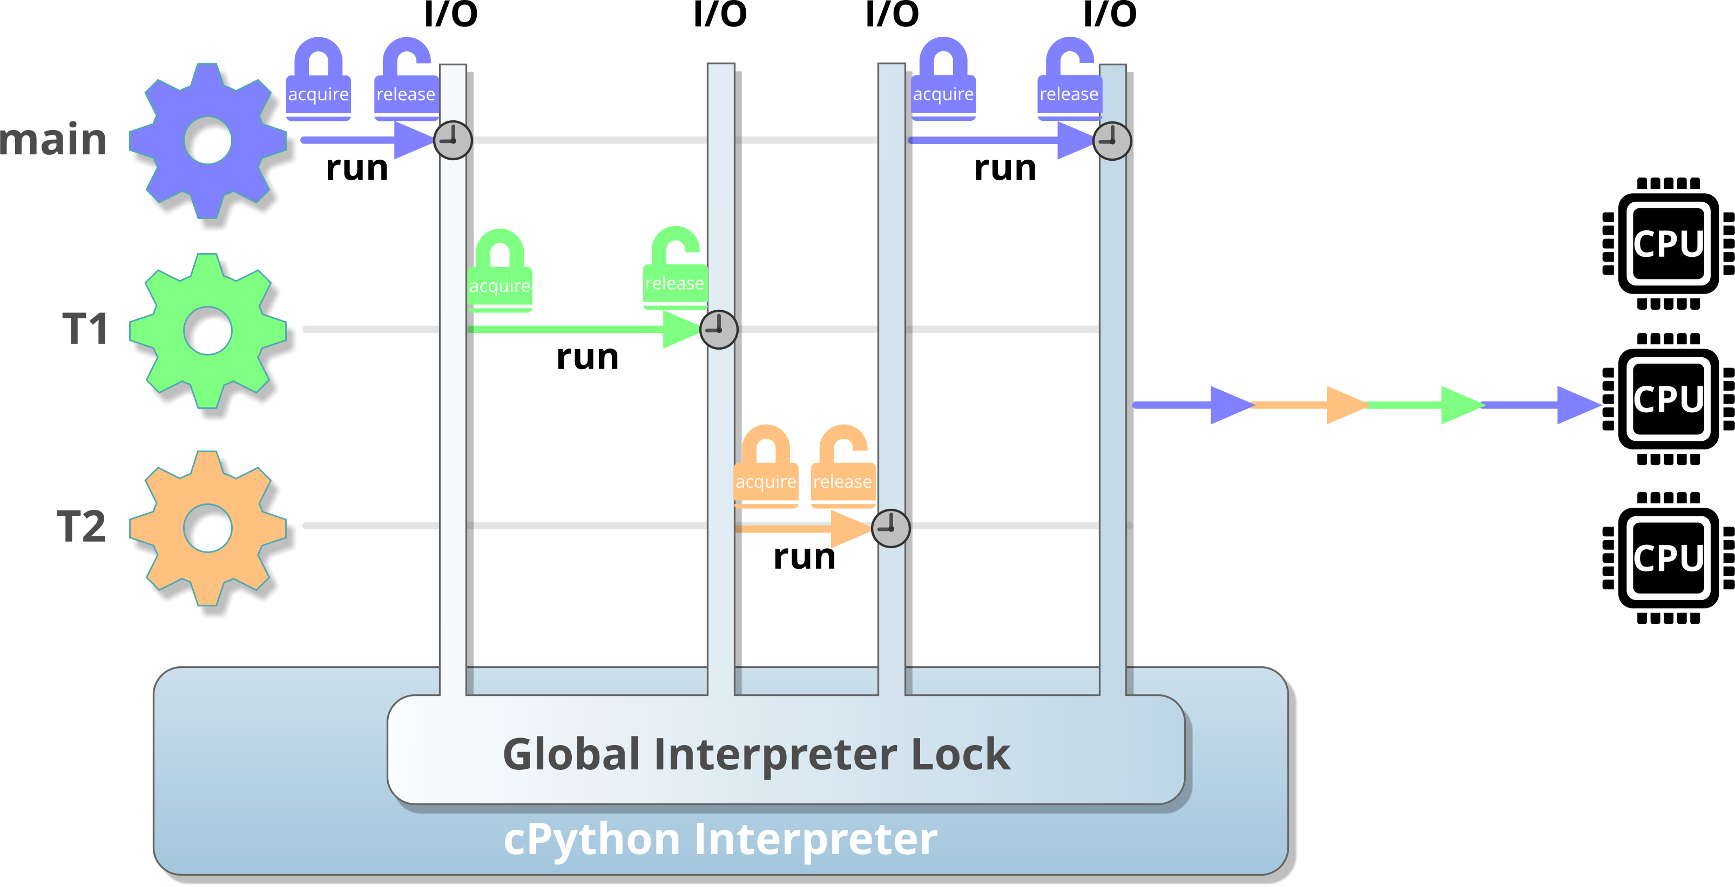
Global Interpreter Lock - GIL
Thread locks are released when I/O occurs or every 100 Ticks byte-code instructions).
Notes:
The Global Interpreter Lock (GIL) in CPython ensures that only one thread can execute Python bytecode at a time, even on multi-core CPUs.
By default, the GIL is released whenever I/O occurs or every 100 ticks, where a tick is roughly a hundred-byte code instructions. However, if a complex operation (such as a math function) executes as a single bytecode operation, the GIL will not be released until that operation completes.
The Global Interpreter Lock (GIL) is like a traffic light, switching between threads, creating the illusion of concurrency, but in reality, only one thread runs at a time – even on multi-core CPUs. However, for I/O-bound tasks (such as network requests or file reading), the GIL is temporarily released while waiting, allowing other threads to run during that time.
There are exceptions, GIL does not apply to C extensions or built-in C modules. These can release the GIL voluntarily, allowing true parallel execution for CPU-bound tasks.
And GIL is just not a problem for Python, Ruby has a similar mechanism called the Global VM Lock (GVL). The Unladen Swallow project aimed to remove the GIL from CPython but was eventually abandoned. So why is GIL still there? GIL simplifies memory management in cPython and removing it would require a massive redesign of CPython’s memory management system.
Alternatives for true parallelism in Python exist using the Parallel Python Library (parallelpython.com), stackless Python (stackless.com) and of course, using the multiprocessing module (spawn processes instead of starting threads).
If you think multi-threading is tricky, you are not the only one. The immortal Guido van Rossum noted that "Unfortunately, for most mortals, thread programming is just Too Hard to get right.... Even in Python…".

Slide 21
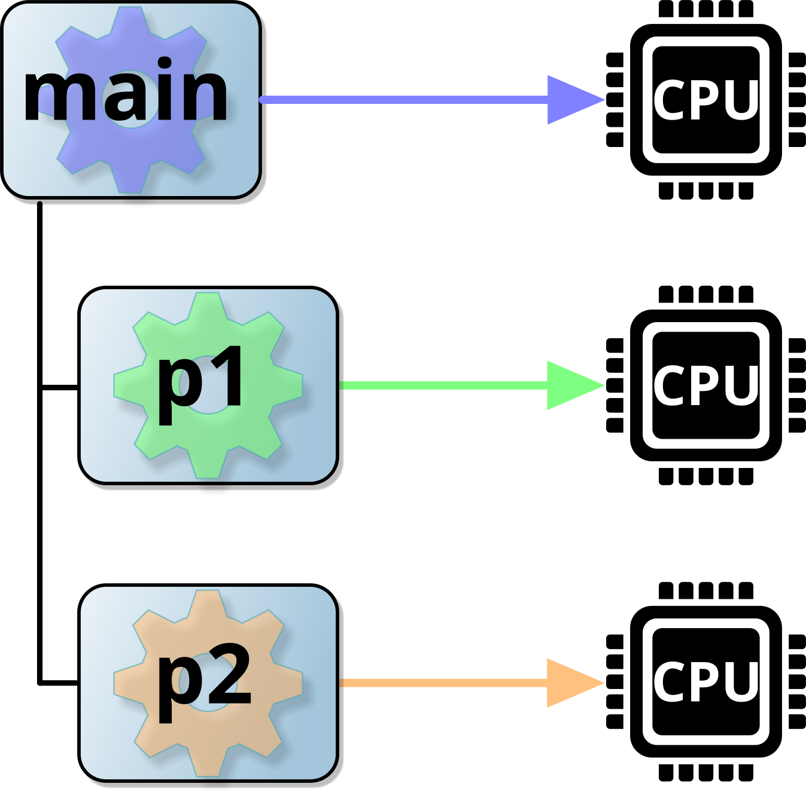
Using the multiprocessing module
Uses processes rather than threads.
Default number of processes is one for each core.
Also supports process pools, and processes across systems.
Pipes and queues for synchronised communication.
import time
import random
from multiprocessing import Process
def do_task(task):
sleep_time = random.uniform(1, 5) # Random sleep 1-5s
print(f"{task} starting.. (Sleep: {sleep_time:.2f}s)")
time.sleep(sleep_time)
print(f"{task} finished.")
if __name__ == "__main__":
p1 = Process(target=do_task, args=("Filter Logs",))
p2 = Process(target=do_task, args=("Update DB",))
p1.start() # Start child processes
p2.start()
print("Main process continues to run...")
p1.join() # Wait for child procs to complete
p2.join()
print("All processes finished.")
If __name__ == “__main__” required as script is re-executed for child processes
Main process continues to run...
Filter Logs starting.. (Sleep: 4.01s)
Update DB starting.. (Sleep: 2.90s)
Update DB finished.
Filter Logs finished.
All processes finished.
Notes:
The multiprocessing module is ideal for distributing data or tasks across multiple processor cores. Unlike threading, it leverages processes instead of threads. However, processes are inherently more resource-intensive, making them inefficient for trivial data sets or tasks.
Since processes run in separate memory spaces, any data exchange between them requires the use of a kernel object, which consumes more system resources than shared variables within the same address space. Nevertheless, shared variables necessitate synchronization, whether within the same process or across different processes. (In-process synchronization is technically better than inter-process synchronization, which we'll address on the next slide.)
The code example on the slide closely resembles the threading example in structure. The key distinction is the inclusion of the if __name__ == "__main__" condition. This is crucial because the script is re-executed for child processes, similar to how fork() operates on UNIX systems.
On Windows, which lacks fork(), the entire script is imported. Therefore, while this condition may be unnecessary on UNIX/Linux, it's recommended for cross-platform compatibility. Notably, in child processes, the value of __name__ becomes "__parents_main__".
Lastly, similar to threading, it is common practice to derive a child class from multiprocessing for enhanced functionality.

Slide 22
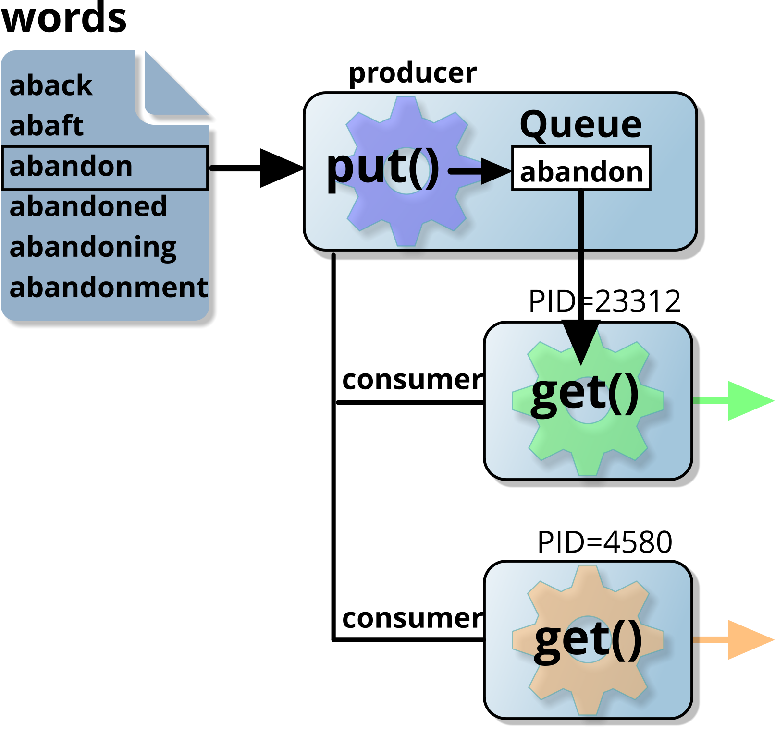
Queue objects
Used by threads and multiprocessing.
Provides a serialised method of communication.
multiprocessing also supports JoinableQueue.
from multiprocessing import Process, Queue
import os
def my_func(queue, id):
while True:
word = queue.get()
if word =="END": break
if len(word) == 7:
print(os.getpid(), ":", word)
if __name__ == "__main__":
queue = Queue()
p1 = Process(target=my_func, args=(queue, "1"))
p2 = Process(target=my_func, args=(queue, "2"))
p1.start()
p2.start()
for line in open(r"c:\labs\words", mode="rt"):
queue.put(line.rstrip("\n"))
queue.put("END")
queue.put("END")
p1.join()
p2.join()
print("All done")
Get an item from the queue
23312 : abandon
23312 : abashed
23312 : abashes
4580 : abasing
23312 : abating
4580 : abdomen
4580 : abducts
23312 : Abelian
Put an item onto the queue
Ensure an 'END' marker for each child process
Notes:
The multiprocessing.Queue module provides a built-in mechanism for inter-process communication. Unlike the queue.Queue module used for thread-based communication, multiprocessing.Queue is designed for processes, handling all necessary locking internally. This means operations on the queue are atomic, eliminating concerns about race conditions when multiple processes access shared data.
Queues are ideal for the producer-consumer model, where one set of processes produces data and adds it to the queue while another set retrieves and processes it. A key advantage of this approach is that it ensures efficient workload distribution. Since processes fetch items from the queue only when they are available to do so, tasks that take varying amounts of time to complete do not block others.
In the given example, there is one producer (the main process, which reads words from a file and places them in the queue) and two consumer processes (p1 and p2), which process the data. Each consumer retrieves words from the queue and prints those that are exactly seven characters long. The termination condition is handled by sending "END" signals to the queue, ensuring each consumer knows when to stop.
In this scenario, with a little more work, we could have used additional methods .task_done() and .join() to create a JoinableQueue instead.
Beyond queues, the multiprocessing module also provides other synchronization primitives, such as events and semaphores, for more advanced coordination between processes.
How could we distribute the workload without using a queue? We could split the 'words' file in half and give each part to a different process. However, this could lead to an uneven workload, as one process might finish much earlier than the other, leaving one processor idle.

Slide 23

Threading Module – Concurrency, not parallelism
Threads share memory and run within the same process.
GIL restricts only one thread to run at a time
Use for I/O-bound tasks like network requests or file I/O.
Requires locks and synchronisation objects to avoid race conditions.
Multiprocessing Module - true parallelism
Runs separate processes with its own memory space.
Bypasses GIL for parallel execution on multiple cores.
Use for CPU-bound tasks, like data analysis or heavy computations.
Uses queues and shared objects for safe communication between processes.
Use if __name__ == "__main__": in multiprocessing code
Summary

Slide 24
An intro to Asyncio
Contents
Programming models
Where does async fit in?
Using asyncio
Examples using Asyncio
Async language
Basics
Synchronous Vs Asynchronous
Waiting for external data
Summary

Slide 25
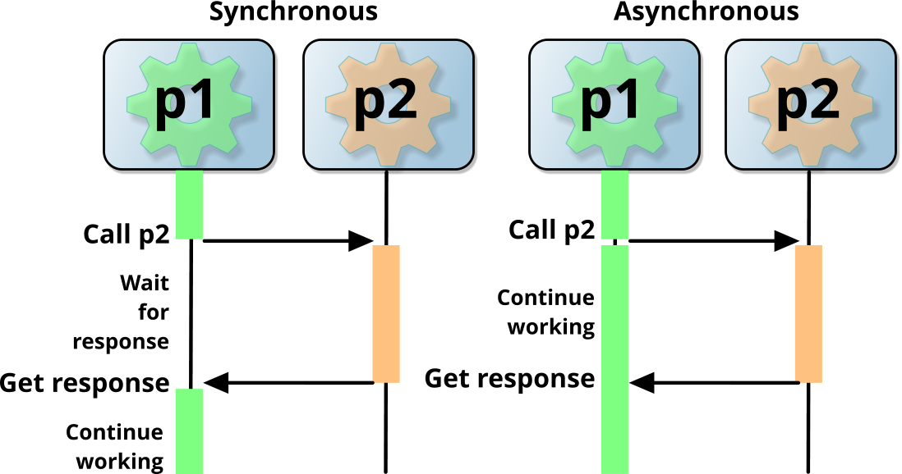
Programming models
Synchronous Vs Asynchronous
Sync
Traditional and predictable programming
Executes sequentially, one task at a time
Easy to understand and debug
Suited for CPU bound tasks and simple scripts
Async
Executes tasks concurrently without blocking
Can improve performance and responsiveness
Careful of race conditions
Ideal for I/O bound tasks such as network requests
Suited for web scraping, Web servers, fetching data from multiple APIs
Python asyncio module - uses single-threaded, non-blocking event loops
Notes:
In Python, synchronous programming follows a sequential execution model where tasks are executed one at a time, in the order they appear in the code. Each task must complete before the next one can begin. This approach is straightforward and easier to debug, as the flow of execution is predictable. However, synchronous code can become inefficient when dealing with tasks that involve waiting, such as network requests or file I/O operations. The program remains blocked until the current task is finished, which can lead to performance bottlenecks, especially in applications that need to handle multiple tasks concurrently. Synchronous programming is well-suited for CPU-bound tasks that require heavy computation or when strict execution order is necessary, such as database transactions or simple scripts.
On the other hand, asynchronous programming allows multiple tasks to run concurrently without blocking the execution of other tasks. This is achieved using Python’s asyncio library and the async and await keywords. With this model, the program can initiate a task, such as fetching data from an API, and move on to other tasks while waiting for the response. This approach significantly improves efficiency in I/O-bound operations, like handling multiple client requests in a web server or fetching data from various sources simultaneously. However, asynchronous code can be more complex to manage due to potential race conditions and the need for careful error handling. Despite this complexity, it is essential for building scalable and responsive applications.

Slide 26
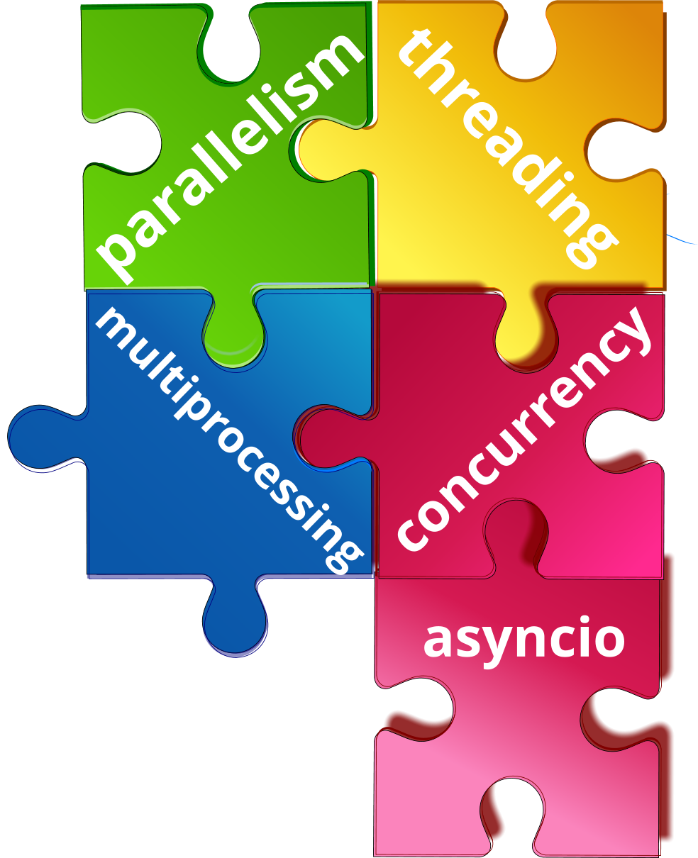
Where does asyncio fit on?
A (somewhat tricky) recap
Parallelism (multiprocessing)
Multiple cores work together to complete single job faster
Bypasses GIL - true parallel execution
Suited for CPU-bound tasks like data analysis
Multiprocessing (multiprocessing)
Separate independent processes run on multiple cores
Bypasses GIL - each has own memory space
Effective for data analysis and machine learning
Concurrency (concurrent.futures, asyncio)
Multiple tasks start, run and finish independently, but not always at same time
Allows efficient task switching during I/O bound tasks
Threading (threading)
Multiple threads run with a single process, sharing same memory
Restricted by GIL so ideal for wait based tasks like File I/O. network requests
Notes:
In Python, different models handle tasks concurrently or in parallel, depending on whether the program is CPU-bound or I/O-bound. Understanding where asynchronous programming (asyncio) fits within these models is key to writing efficient and scalable code.
Parallelism refers to running multiple tasks at the same time on multiple CPU cores, effectively bypassing Python's Global Interpreter Lock (GIL). This allows true parallel execution, making it ideal for CPU-bound tasks like data analysis and scientific computing. Python’s multiprocessing module enables this by creating separate processes, each with its own memory space.
Multiprocessing, on the other hand, involves running separate, independent processes on multiple cores. Each process operates in isolation with its own memory, which also bypasses the GIL. This approach is highly effective for heavy computation tasks like machine learning or large-scale data processing.
Concurrency, which is where asynchronous programming fits in, allows multiple tasks to start, run, and complete independently, but not necessarily at the same time. Python’s asyncio module and concurrent.futures library allow for efficient task switching during I/O-bound operations, such as handling multiple API requests or managing thousands of web sockets. Unlike multiprocessing, concurrency does not achieve true parallel execution but improves performance by avoiding idle time while waiting for external resources.
Lastly, threading allows multiple threads to run within a single process, sharing the same memory. However, due to the GIL, threading is limited in performance for CPU-bound tasks. It is best suited for tasks that spend time waiting, such as file I/O or web scraping.
In this field, asyncio fits within the concurrency model, excelling at handling high numbers of I/O-bound tasks efficiently without blocking the main thread, making it essential for building scalable network servers or real-time applications.

Slide 27
asyncio - look and feel of concurrency
asyncio - “the library to write concurrent code”
Single-threaded design that uses an event loop
Not parallelism, more aligned to threading than multiprocessing
Provides a foundation for running/managing coroutines
asyncio - the package (Python 3.4 but rapidly evolved from 3.7)
Provides two new keywords async/await for defining coroutines
Provides a foundation for running/managing coroutines
asyncio - the components
async – a piece of code which tells python that the object can be used asynchronously
await – this tells the code to pause and wait for something to happen.
async def test():
some code
async def test():
await y()
return y
Notes:
Python's asyncio module allows asynchronous, non-blocking execution. It stands for asynchronous input output and can provide high concurrency. Unlike the threading or multiprocessing modules, which create separate threads or processes, asyncio runs everything within a single thread using an event loop. This approach is highly efficient for handling I/O-bound tasks, such as reading from files, making API calls, or managing network connections.
The core concept is the coroutine, which is defined using the async keyword. Coroutines can be paused with the await keyword, allowing other tasks to run while waiting for an I/O operation to complete. This makes asyncio more efficient than traditional threading for tasks that spend most of their time waiting for external resources.
By using the asyncio event loop, we can manage thousands of tasks concurrently, without the overhead of creating multiple threads or processes. Remember asyncio is not suitable for CPU-bound tasks, as it still runs on a single core and is still restricted by GIL
In the next slides, we'll explore how to define coroutines and use the event loop to manage multiple asynchronous tasks.

Slide 28
Example using asyncio
async tells python function can be paused
import asyncio
async def fetch_data(source):
print(f"Fetching data from {source}...")
await asyncio.sleep(2) # Simulate network request
print(f"Finished fetching from {source}")
return f"Data from {source}"
async def main():
# Run multiple tasks concurrently
task1 = asyncio.create_task(fetch_data("API 1"))
task2 = asyncio.create_task(fetch_data("API 2"))
task3 = asyncio.create_task(fetch_data("API 3"))
# Wait for all tasks to complete
results = await asyncio.gather(task1, task2, task3)
print(results)
asyncio.run(main())
await tells the coroutine to pause
asyncio.sleep manages a short pause, but other coroutines continue
Run an async function concurrently as separate task and return task object
Wait for all concurrent tasks to finish.
Return a list of results from all tasks
Fetching data from API 1...
Fetching data from API 2...
Fetching data from API 3...
Finished fetching from API 1
Finished fetching from API 2
Finished fetching from API 3
['Data from API 1', 'Data from API 2', 'Data from API 3']
Without asyncio, finish in 6s (2s per call)
With asyncio, finish in 2s
Notes:
In this example, we are using asyncio to handle multiple tasks concurrently. The fetch_data() function simulates a network request by pausing for two seconds using await asyncio.sleep(2). When the main() function is called, we use asyncio.create_task() to create three separate tasks, each running fetch_data() with different inputs. By doing this, the tasks are started immediately and run concurrently, rather than one after the other.
Once the tasks are created, we use await asyncio.gather() to wait for all the tasks to finish and collect the results from each task, and return as a list, which is then printed. Because the tasks are running at the same time, the total execution time is only 2 seconds, rather than 6 seconds if the tasks were executed sequentially.
This approach is particularly useful for I/O-bound operations, such as making multiple API requests or reading from files, where the program would otherwise spend time waiting for a response. By using asyncio, we can make the program more efficient by switching between tasks while waiting for other tasks to finish.
Using asyncio.sleep(), instead of time.sleep(2) may seem trivial, but they are often used as placeholders for real-world processes that involve waiting. The simplest example of something you can "wait" on is a sleep() call, which essentially does nothing. However, in this context, time.sleep() represents any blocking, time-consuming function, while asyncio.sleep() acts as a stand-in for a non-blocking operation that also takes time to complete, such as waiting for a network response or reading from a file.

Slide 29
Example waiting for external data
import httpx # Use instead of requests(blocking library) and works with asyncio
import asyncio
async def fetch_data():
print("Loading...")
async with httpx.AsyncClient() as client:
response = await client.get('https://jsonplaceholder.typicode.com/todos/')
if response.status_code != 200:
print("Data Not Collected")
return None
print("Data Collected")
return response.json()
async def get_data():
data = await fetch_data()
return data
data = asyncio.run(get_data())
Notes:
In this example, we are using asyncio to handle an HTTP request in a non-blocking way. The fetch_data() function makes a request to an external API using httpx.AsyncClient(), which is an asynchronous alternative to the traditional requests library. This allows the program to wait for the server's response without blocking the main thread, making it more efficient when handling multiple requests.
By using the async with statement, we ensure that the connection is properly managed and automatically closed after the request is complete. If the server responds with a status code other than 200, we handle the error and return None. Otherwise, the data is returned as a JSON object.
The get_data() function then awaits the result of fetch_data(), allowing us to access the data once the request has finished. Finally, asyncio.run() is used to run the coroutine and return the data.
This approach is ideal for I/O-bound tasks such as fetching data from APIs or accessing databases, as it allows the program to remain responsive while waiting for external resources.

Slide 30
Built in library for asynchronous programming
Runs multiple tasks concurrently
Without blocking main thread
Uses coroutines and event loop
async functions that can paused/resumed
await keyword waits for tasks to complete
asyncio.create_task() runs tasks concurrently
asyncio.gather() waits for multiple tasks to finish
asyncio.run() runs event loop
asyncio.sleep() is non blocking
Handles I/O bound tasks efficiently
API requests
File I/O
Fetching external data
Can be used with frameworks such as Django or Flask to build Single Page Applications
Summary

